Slide 1
Reverse Engineering Embedded Hardware
Rolfe Bozier
25-Jun-2014

Slide 2
Agenda
Before you start…
Background investigation
Gaining entry
Extracting the firmware
Analysis
What next?

Slide 3
Legalities, ethics, and morals
Is it legal?*
In some jurisdictions, maybe not. The DMCA in the US is intended to prevent this
Did you agree to a licence? If so, you probably want to read it…
Do you actually own the product?
Are you violating IP laws?
Copyright? Maybe if you decide to distribute some derived results
Trademarks and design? Once again, only if you try to copy it
Patents? This has nothing to do with how you obtain your information
Are you violating trade secrets? Sure!
* IANAL

Slide 4
Legalities, ethics, and morals
Is it ethical?
Sure, there is a rich tradition of dismantling technology to see how it works
As an individual there can be a lot to learn
You can customise a product as you wish
Assuming you own the product
Is it moral?
That’s up to you
What do you intend to do with the information?

Slide 5
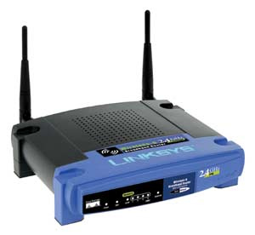
Some examples
The DD-WRT project takes wireless routers (e.g. Linksys WRT45G) and replaces the firmware with their own
The result is a much more capable and configurable router
Or an opportunity for you to make it do whatever you want

Slide 6
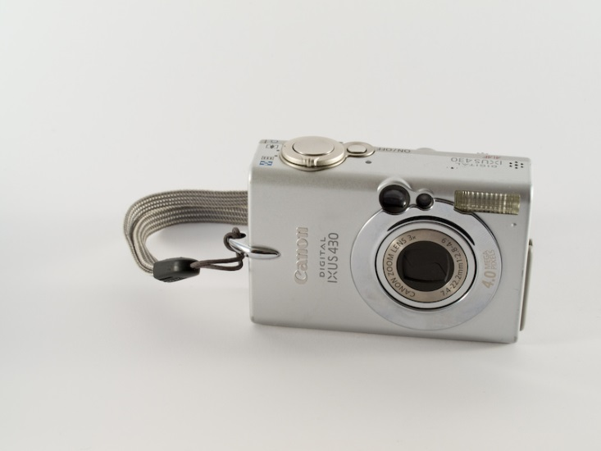
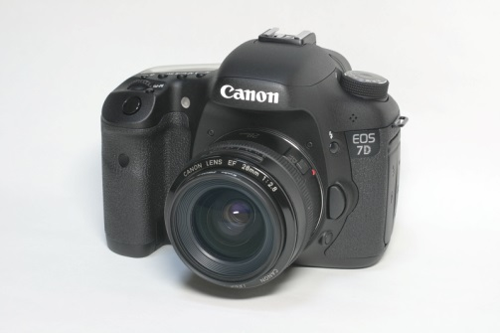
Some examples
The Canon Hack Developers Kit (CHDK) and Magic Lantern projects enhance the firmware on various models of Canon digital cameras
These offer functionality well beyond what Canon envisage (or wish to provide)

Slide 7
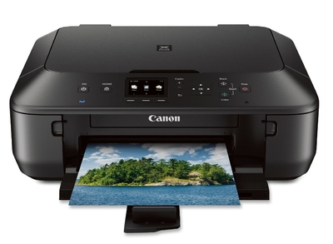
Some examples
My choice of project was the Canon MG5560 printer
Contains CiSRA software
I don’t know much about the internals
Actually, I know next to nothing, so I’m starting from scratch
I didn’t rely on the few tidbits that I did know

Slide 8
Know your opponent
Google around for background information
Sometimes the manufacturer will reveal some useful details- look at the product specs
Maybe other people have done some investigation
Look at similar products
For older products you can often find a service manual online
Look at the product capabilities. The MG5560 has:
Wireless networking
Scanner
Print from LAN and Cloud
Web server for local access
Web client for printing from Picasa, Flickr etc
Updateable firmware (directly over the net)

Slide 9
Know your opponent
Open it up and have a look at the main board[s]
Is there anything interesting written on the board?
Look up the major part numbers on the internet; you probably won’t find some of them
Custom ASICs will have no data
Sometimes parts are rebranded for a company
Sometimes parts are created specifically for a company
Smaller parts often have abbreviated part codes
Sometimes part numbers are sanded off

Slide 10
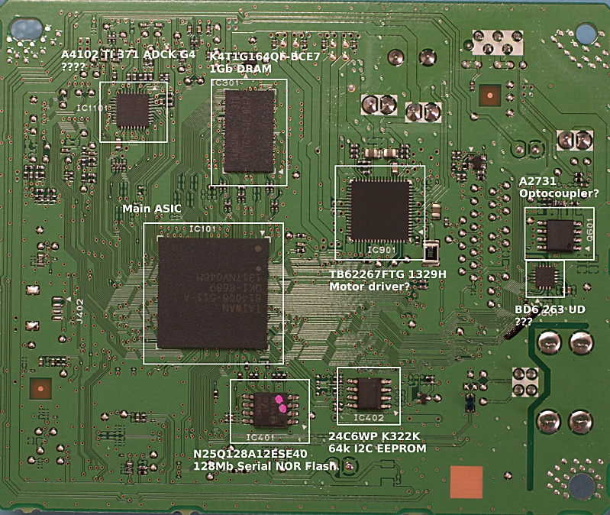
MG5560 main board

Slide 11
MG5560 main board
So… we have:
128 MB SDRAM (working memory)
16 MB Serial Flash (firmware)
4 MB Serial Flash (more firmware?)
8 KB Serial EEPROM (settings)
Custom ASIC (???)
Probably the motor controller
Several other unidentified ICs

Slide 12
Methods of attack
There are several different ways we could choose to attack the device:
Download someone else’s tools (boooring!)
Try a customised firmware load
can be hard in the face of encrypted, signed data
the MG5560 gets its firmware directly over the internet
Extract data from the device
monitor the address/data lines
dump any ROM or Flash chips
Look for a JTAG or serial port on the board
Look for network application weaknesses
Look for suspicious network ports
Companies developing embedded consumer hardware have a responsibility to make them secure
… but they usually don’t do a very good job
It’s the usual cost/benefit tradeoff (gamble)

Slide 13
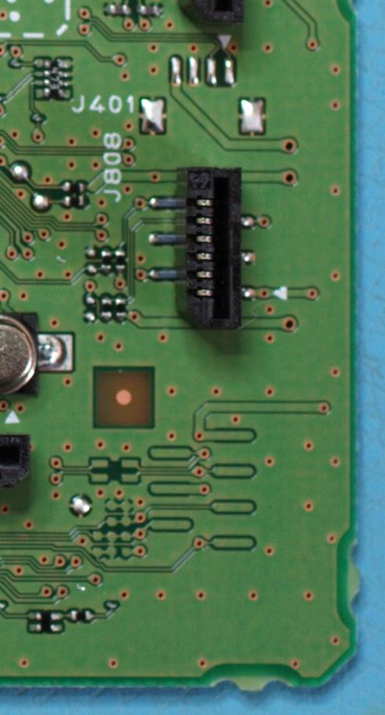
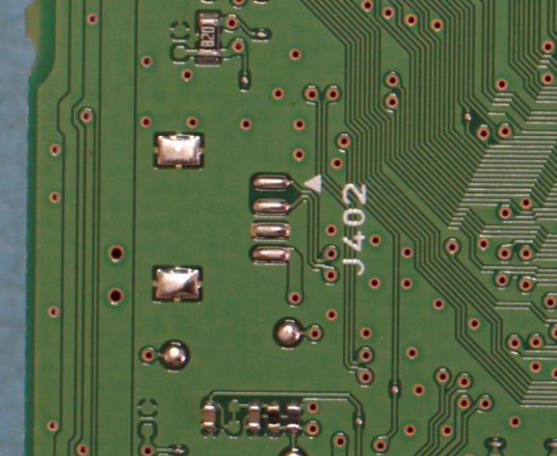
Looking for JTAG / Serial ports
Generally this is pretty easy – manufacturers often need some form of access to the board for verification
Let’s look at our board

Slide 14
Unpopulated headers
J401/J402 are unpopulated 4-pin headers (Ground + 3.3V + 2 data lines)
These could possibly be serial connections
There is another unlabeled missing connector, but it is missing associated components so it may be for a different product
There are other test points around, maybe some combination of these provide a JTAG connection, but it would be a fair amount of work to be sure
Connecting an oscilloscope up to the data lines and restarting the printer a couple of times revealed signals on one line
Looks like 19.2K 8-bit serial traffic
The protocol is a bit non-standard though
Connect via a USB/Serial bridge to my desktop, start up a terminal program and after much mucking around I get command prompt

Slide 15
J401 serial port
DRYOS version 2.3, release #0049+SMP
Copyright (C) 1997-2011 by CANON Inc.
subsystem version : build_13f_130617_01
wlan available
Dry> help
[OTG]
otg otg_init otg_cleanup
[Debug]
task sem event mutex cond mq timer itsk isem iflg idtq imbx impf impl icyc mkobjsize prio release resume suspend kill delete mkcfg objinfo meminfo xd xm cmp
[Test]
echod gtime loosesock netecho netrace mctalk mktest iotest chkit4 time arpsend chkspi pingall setipsec
[Miscellaneous]
date dminfo exit shutdown vers
[Network]
arp dnsutil host ifconfig netstat nsupdate mbufs ping route sockhalt tcputil pngl slaup
[deleted]
DryOS is a Canon proprietary embedded OS (no information available)
based on μITRON (some information can be found on the net)
DryOS is also used in newer Canon DSLRs
so check out the CHDK & Magic Lantern webpages

Slide 16
DryOS
xd – memory dump, xm – memory modify
Playing about with xd, eventually crash it:
Dry> xd 45800000 20 b
0 1 2 3 4 5 6 7 8 9 a b c d e f 0123456789abcdef
--- Error User Exception ---
[InfoReg]:A0 0x9f946a74 A8 0x9f95cb44
[InfoReg]:A1 0x1fc979e0 A9 0x0000005f
[InfoReg]:A2 0x45800000 A10 0x0000000a
[InfoReg]:A3 0x1fa39d40 A11 0x45800000
[InfoReg]:A4 0x00000001 A12 0x1fd9c708
[InfoReg]:A5 0x00000000 A13 0x00000000
[InfoReg]:A6 0x1fc979e0 A14 0x00000010
[InfoReg]:A7 0x00000002 A15 0x00000000
[InfoReg]:PS 0x00060130 EXCAUSE 0x00000003
[InfoReg]:EPC1 0x1f95cb79 EPC2 0x00000000
[InfoReg]:WINDOWBASE 0x00000007 WINDOWSTART 0x00000080
[InfoReg]:EPC 0xc283c9fe EPS 0x00000000
[InfoReg]:EXCSAVE1 0x1fa39d40 EXCSAVE2 0x00000000
[InfoReg]:LBEG 0x1fa1f404 LEND 0x1fa1f40e
[InfoReg]:LCOUNT 0x9fa247b5 SAR 0x00000019
[InfoReg]:IBREAKENA 0x00000000 EXCVADDR 0x45800000
[InfoReg]:DDR 0x00000000 DEBUGCAUSE 0x00000000
[InfoReg]:IBREAKA0 0x00000000 IBREAKA1 0x00000000
[InfoReg]:DBREAKA0 0x00000000 DBREAKA1 0x00000000
[InfoReg]:DEPC 0x00000000 EPS2 0x00000000
[InfoReg]:INTERRUPT 0x00000001 INTENABLE 0x00000002
[InfoReg]:CCOUNT 0xe46dccc9 ICOUNT 0x00000000
[InfoReg]:ICOUNTLEVEL 0x00000000
Register names – very interesting!

Slide 17
Firmware dumping
Dumping out memory using xd is interesting, but I want more data
…what about those Serial Flash chips?
Data sheet is readily available, including protocols
Desolder from board, connect to some wires
Put on breadboard with an AVR microcontroller
Write some code to retrieve data from Flash, and dump over a serial connection to my desktop
Put the IC back on the board
Now we can do some serious analysis of the firmware

Slide 18
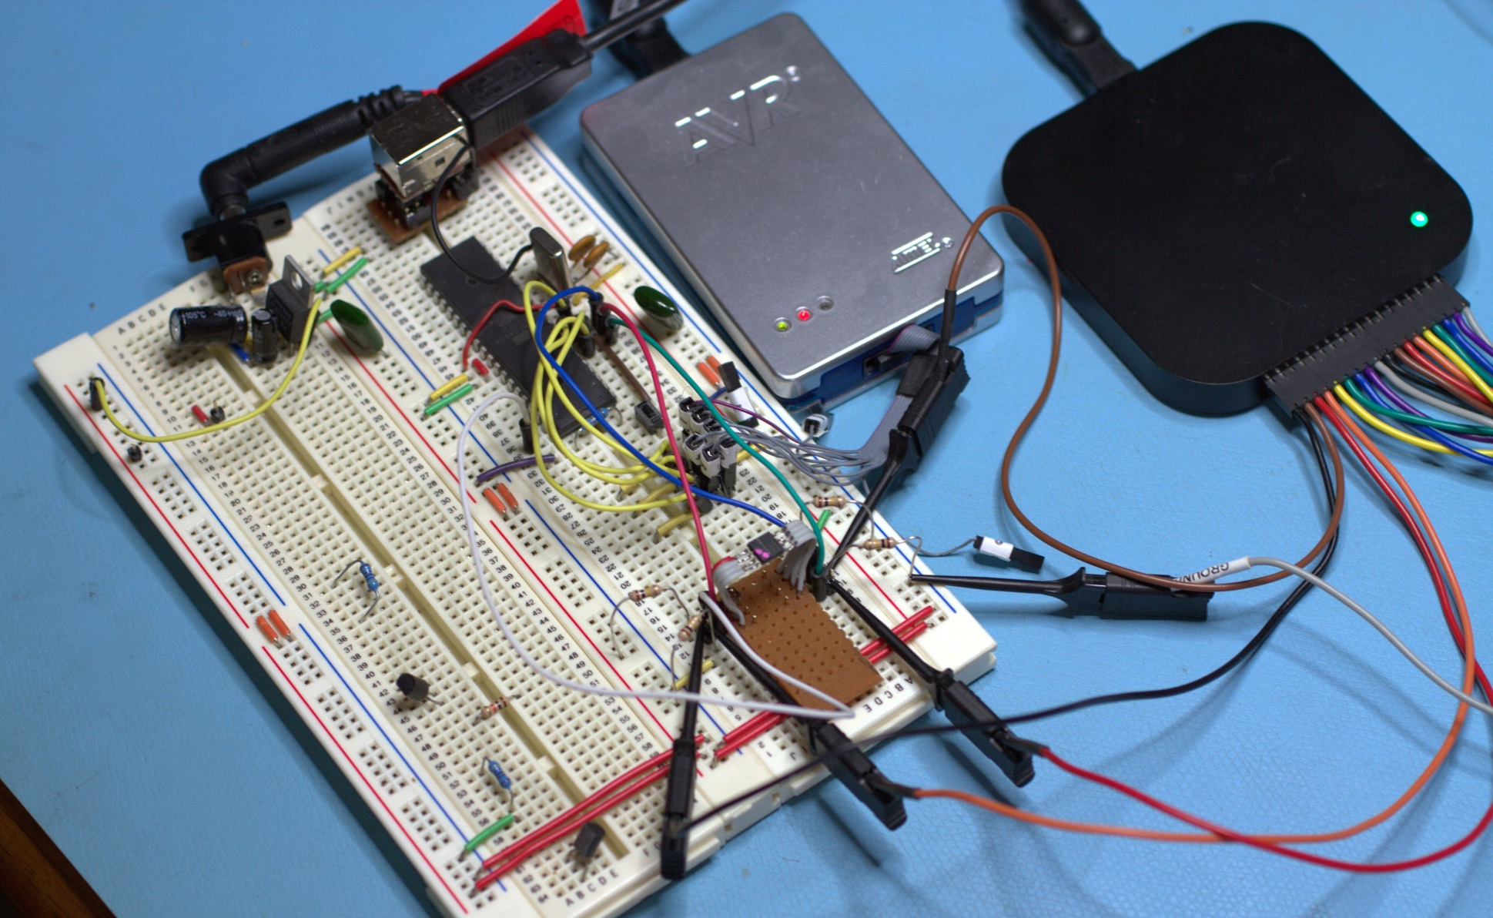
My setup

Slide 19
Firmware dumping
Firmware will contain code and data (binary and text)
Dump out all the string data – lots of info there
Strings from zlib code + compressed data → write a script to decompress the deflated blobs
What about the executable code?
Sometimes you can tell from the hex dump
Repeated patterns every 4 bytes suggests 4-byte instructions (RISC, e.g. MIPS, SPARC, ARM)
Try googling a few dozen bytes of hex code
Try disassembling using different tools
onlinedisassembler.com lets you choose from dozens of processors
I identified ARM code + unknown code
Remember the register names I found?
They provided the clue that the other code was for a “Relax” processor
Downloaded gcc cross-compiler tools for both architectures
Code disassembly gives clues about relevant address spaces

Slide 20
Constructing a memory map
I divided the address space up into 16M chunks and started working out what data (if any) was in each
There is some element of trial and error
 | -0 | -1 | -2 | -3 | -4 | -5 | -6 | -7 | -8 | -9 | -A | -B | -C | -D | -E | -F
0- |  |  |  |  |  |  |  | 1F | 00 | 01 | 02 | 03 | 04 | 05 | 06 | 1F
1- | 00 | 01 | 02 | 03 | 04 | 05 | 06 | 1F | 00 | 01 | 02 | 03 | 04 | 05 | 06
2- | 00 | 01 | 02 | 03 | 04 | 05 | 06 | 1F | 00 | 01 | 02 | 03 | 04 | 05 | 06 | 1F |  |  |  |  | Flash
3- | 00 | 01 | 02 | 03 | 04 | 05 | 06 | 1F | 00 | 01 | 02 | 03 | 04 | 05 | 06 | 1F |  |  |  |  | Hardware?
4- |  |  |  |  |  |  |  |  |  |  |  |  |  |  |  |  |  |  |  |  | RAM
5- |  |  |  |  |  |  |  |  |  |  |  |  |  |  |  |  |  |  |  |  | ROM
6- |  |  |  |  |  |  |  |  |  |  |  |  |  |  |  |  |  |  |  |  | invalid
7- |  |  |  |  |  |  |  |  |  |  |  |  |  |  |  |  |  |  |  |  | EEPROM?
8-
9-
A-
B-
C-
D-
E- |  | E0 | E0 | E0 | E0 | E0 | E0 | E0 | ? | E8 | E8 | E8 | E8 | E8 | E8 | E8
F- |  | F0 | F0 | F0 | F0 | F0 | F0 | F0 |  | F8 | F8 | F8 | F8 | F8 | F8 | F8

Slide 21
Constructing a memory map
As I built up my understanding, I would dump out 16M blocks using xd and save to disk
This gave me access to RAM and ROM, as well as the Flash-based data
So, this gives me complete access to the Relax side of the dual-CPU device
I’ve written a bunch of scripts that disassemble code and annotate functions that I’ve worked out
(I’ve identified about 250 functions out of 6600)

Slide 22
Where to next?
First, I need to unbrick the printer ☺
It would be nice to get access to the ARM processor
Presumably J402 is the way in, but it doesn’t respond in the same way
Maybe introduce some non-trivial changes to the OS
Ideal goal is to work out a way to get entry without a physical connection

